Slide 1


GSSS – HACKATHON – IOT – 2021
Team ID : WIMAC2021-8
Team Name : OMEGA
College Name : Dayananda Sagar College of Engineering
Team Members : G Chandan
Guruprasada Hegde
Spoorthy M K
Meghana S

Slide 2

Security System for a single human living alone at home
Problem Statement

Slide 3
1. Unavoidable incidence. 2. Unauthorized access of premises.
Analysis

Slide 4
1. Monitoring the environment. 2. Acquiring the data. 3. Protocol verification. 4. Notification to Guardian.
Solution

Slide 5
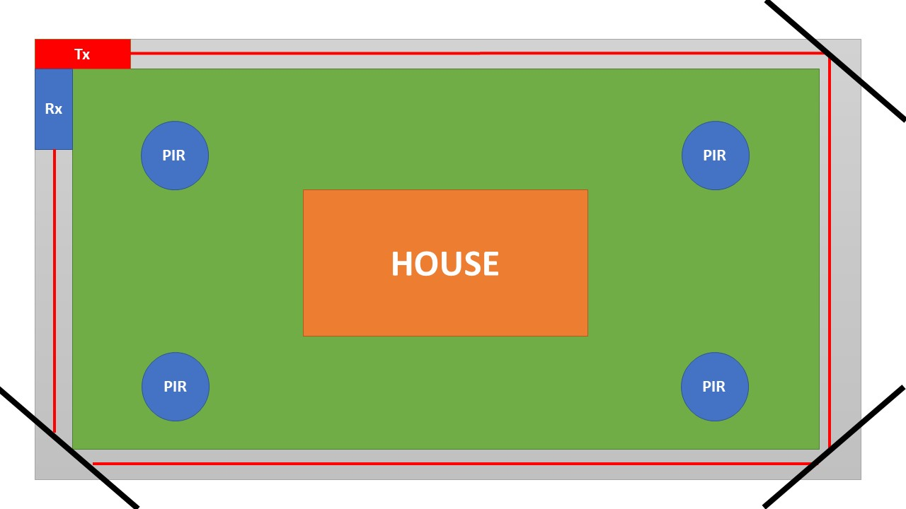
Level 1
Level 2
Level 3

Slide 6
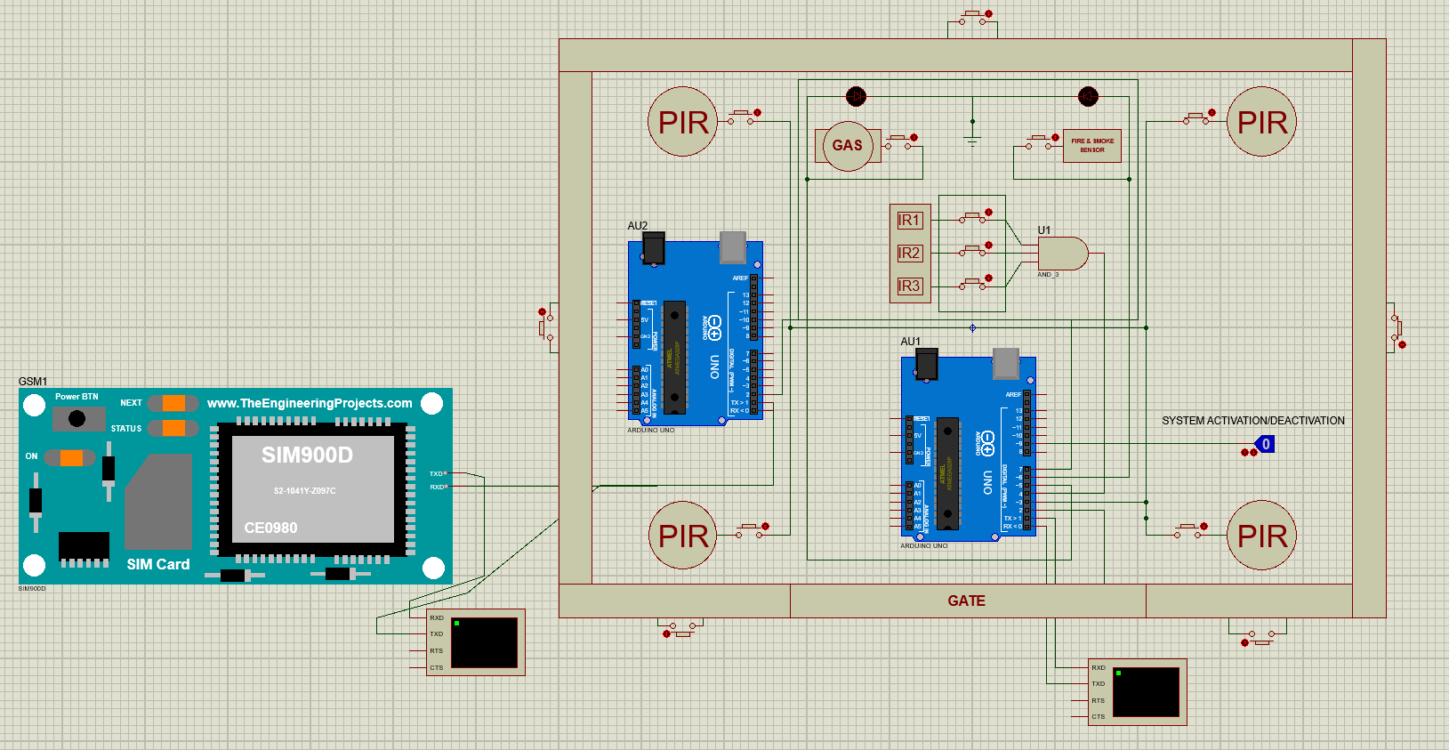
Simulation

Slide 7
Helps individual living at home feel safe and secure
Conclusion

Slide 8
Thank you

